Slide 1
ELECTRIC WATER HEATER
TO: AMIT BEYOND EDUCATION
BY: AHMED MOHAMED ALAA
OMAR ADS
CLASS: D26- ONLINE

Slide 2
INTRODUCTION
An electric heater is an electrical appliance that converts electrical energy into heat.
After start check the temperature of the water
According to the difference between temperature needed and sensed , Action is taken Either by Heating or Cooling
Using Time management Unit Depending on Timer0 to get accurate reading in specific time
Using Analog to Digital Convertor to Sense the temperature of the system
using proteus as a Simulation protocol to the original system
Using Decoder to transmit data to seven segments

Slide 3
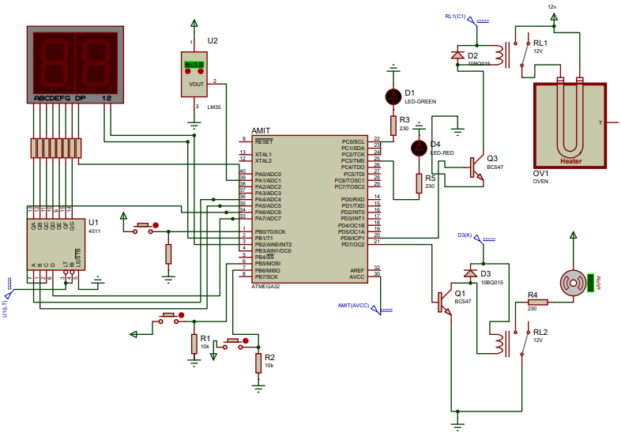
SIMULATION CIRCUIT

Slide 4
TIME MANAGMENT UNIT (TMU)
For our project we use a time management unit
we divide our systems into different task with different priorities.
Each task runs at a certain periodicity
periodicity is the number of ticks multiplied by the tick time set on timer0.
After a task is run, it is put to sleep for its periodicity time.
If two tasks are supposed to run at the same time, the task with the higher priority runs first.

Slide 5
TIME MANAGMENT UNIT (TMU)
Tasks | Function | Priority | Periodicity
Task1 | ON and OFF the System | 5 | 20ms
Task2 | Tempeature sensing | 2 | 60ms
Task3 | Temprature setting | 0 | 20ms
Task4 | Seven segments Blinking | 3 | 1second
Task5 | Heating and cooling System | 4 | 40ms
Task6 | Heating/cooling Led | 1 | 1second

Slide 6
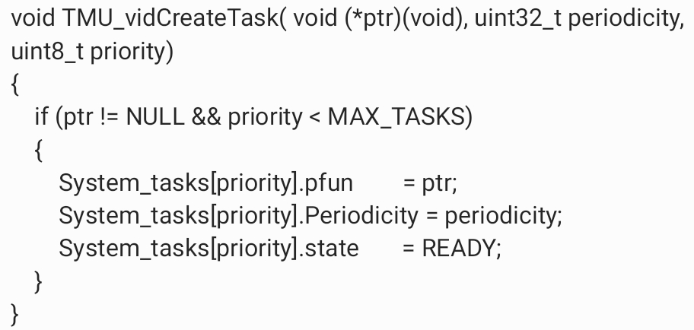
TIME MANAGMENT UNIT (Creat Task)

Slide 7
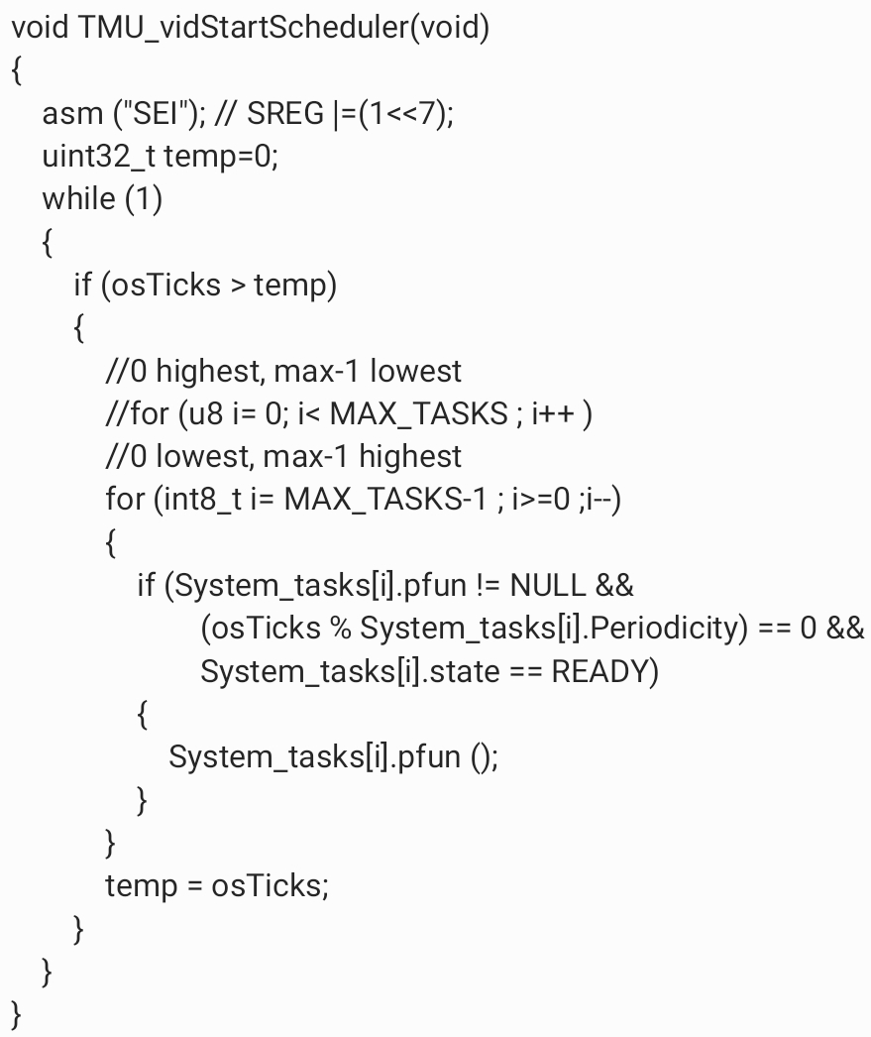
TIME MANAGMENT UNIT (Start scheduler)

Slide 8
Task1: (ON/OFF SYSTEM)
power is connected to the heater, the system is in OFF state.
When the "ON/OFF "button is pressed, the system goes to ON state.
the "ON/OFF "button is pressed again, the system goes to OFF state.
When the system on Instates EEPROM read the past set temperature
First number read Null, the temperature by default set to 60°c
In the next Run, the temperature set to the past set before close

Slide 9
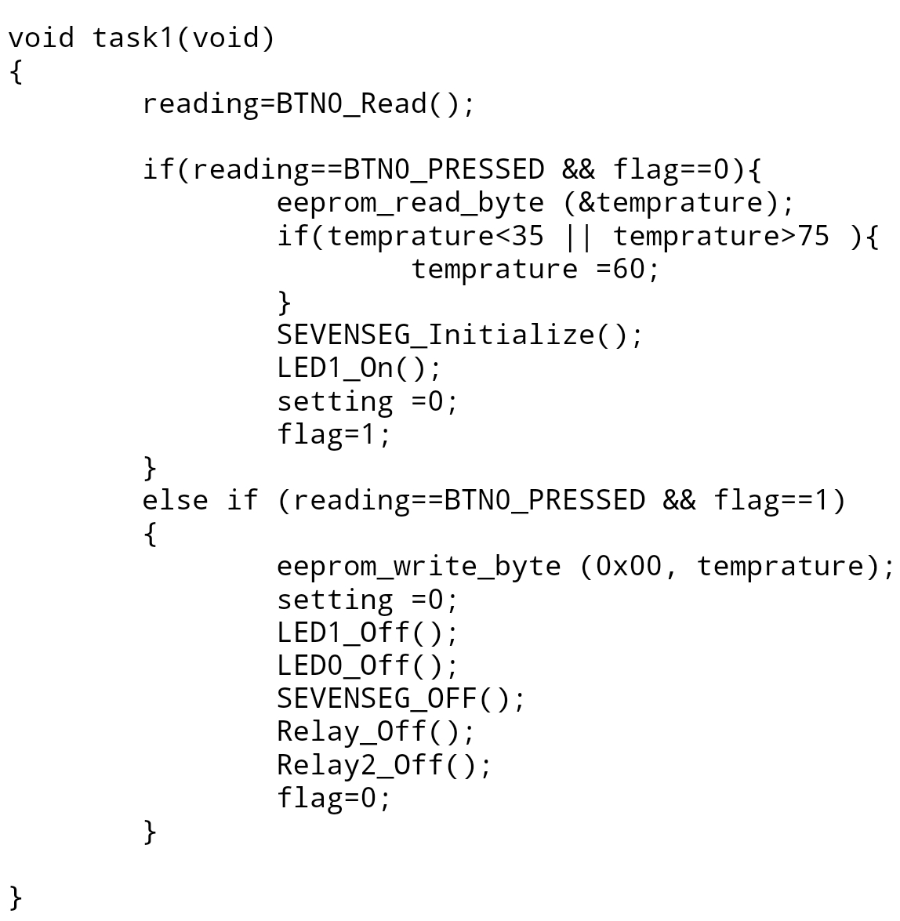
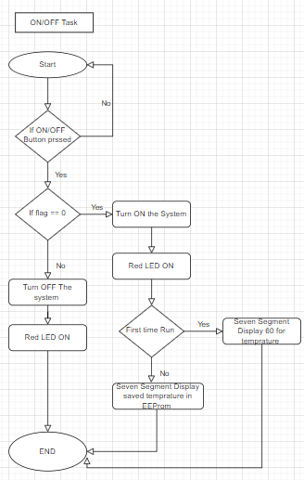
Task1: (ON/OFF SYSTEM)

Slide 10
Task2: (Temprature Sensing)
Using LM35 the heated water to measure its temperature (Using ADC).
The sensor measure the temperature every 100ms
After 10 Readings, Calculate the Average of the temperature read
Clear All Readings and Read another 10 readings

Slide 11
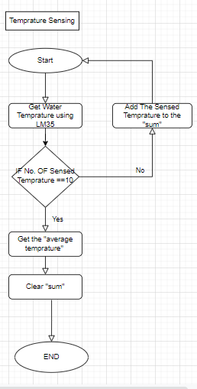
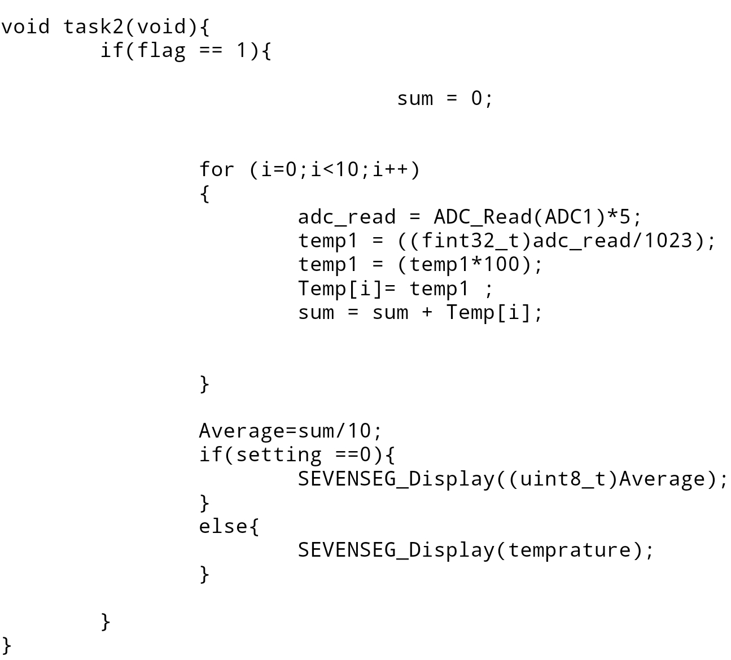
Task2: (Temprature Sensing)

Slide 12
Task3: (Temprature Setting)
Two buttons to set required Temprature
The first press trigger the setting mode
The second press change the setting temprature
The range of the setting temprature is between 35 and 75 degree
UP Button increase set temprature by 5 degrees
Down Button Decrease the set temprature by 5 degrees
After 5 Seconds from not pressing the UP or Down button the setting mode is OFF
Save the set temprature to EEPROM

Slide 13
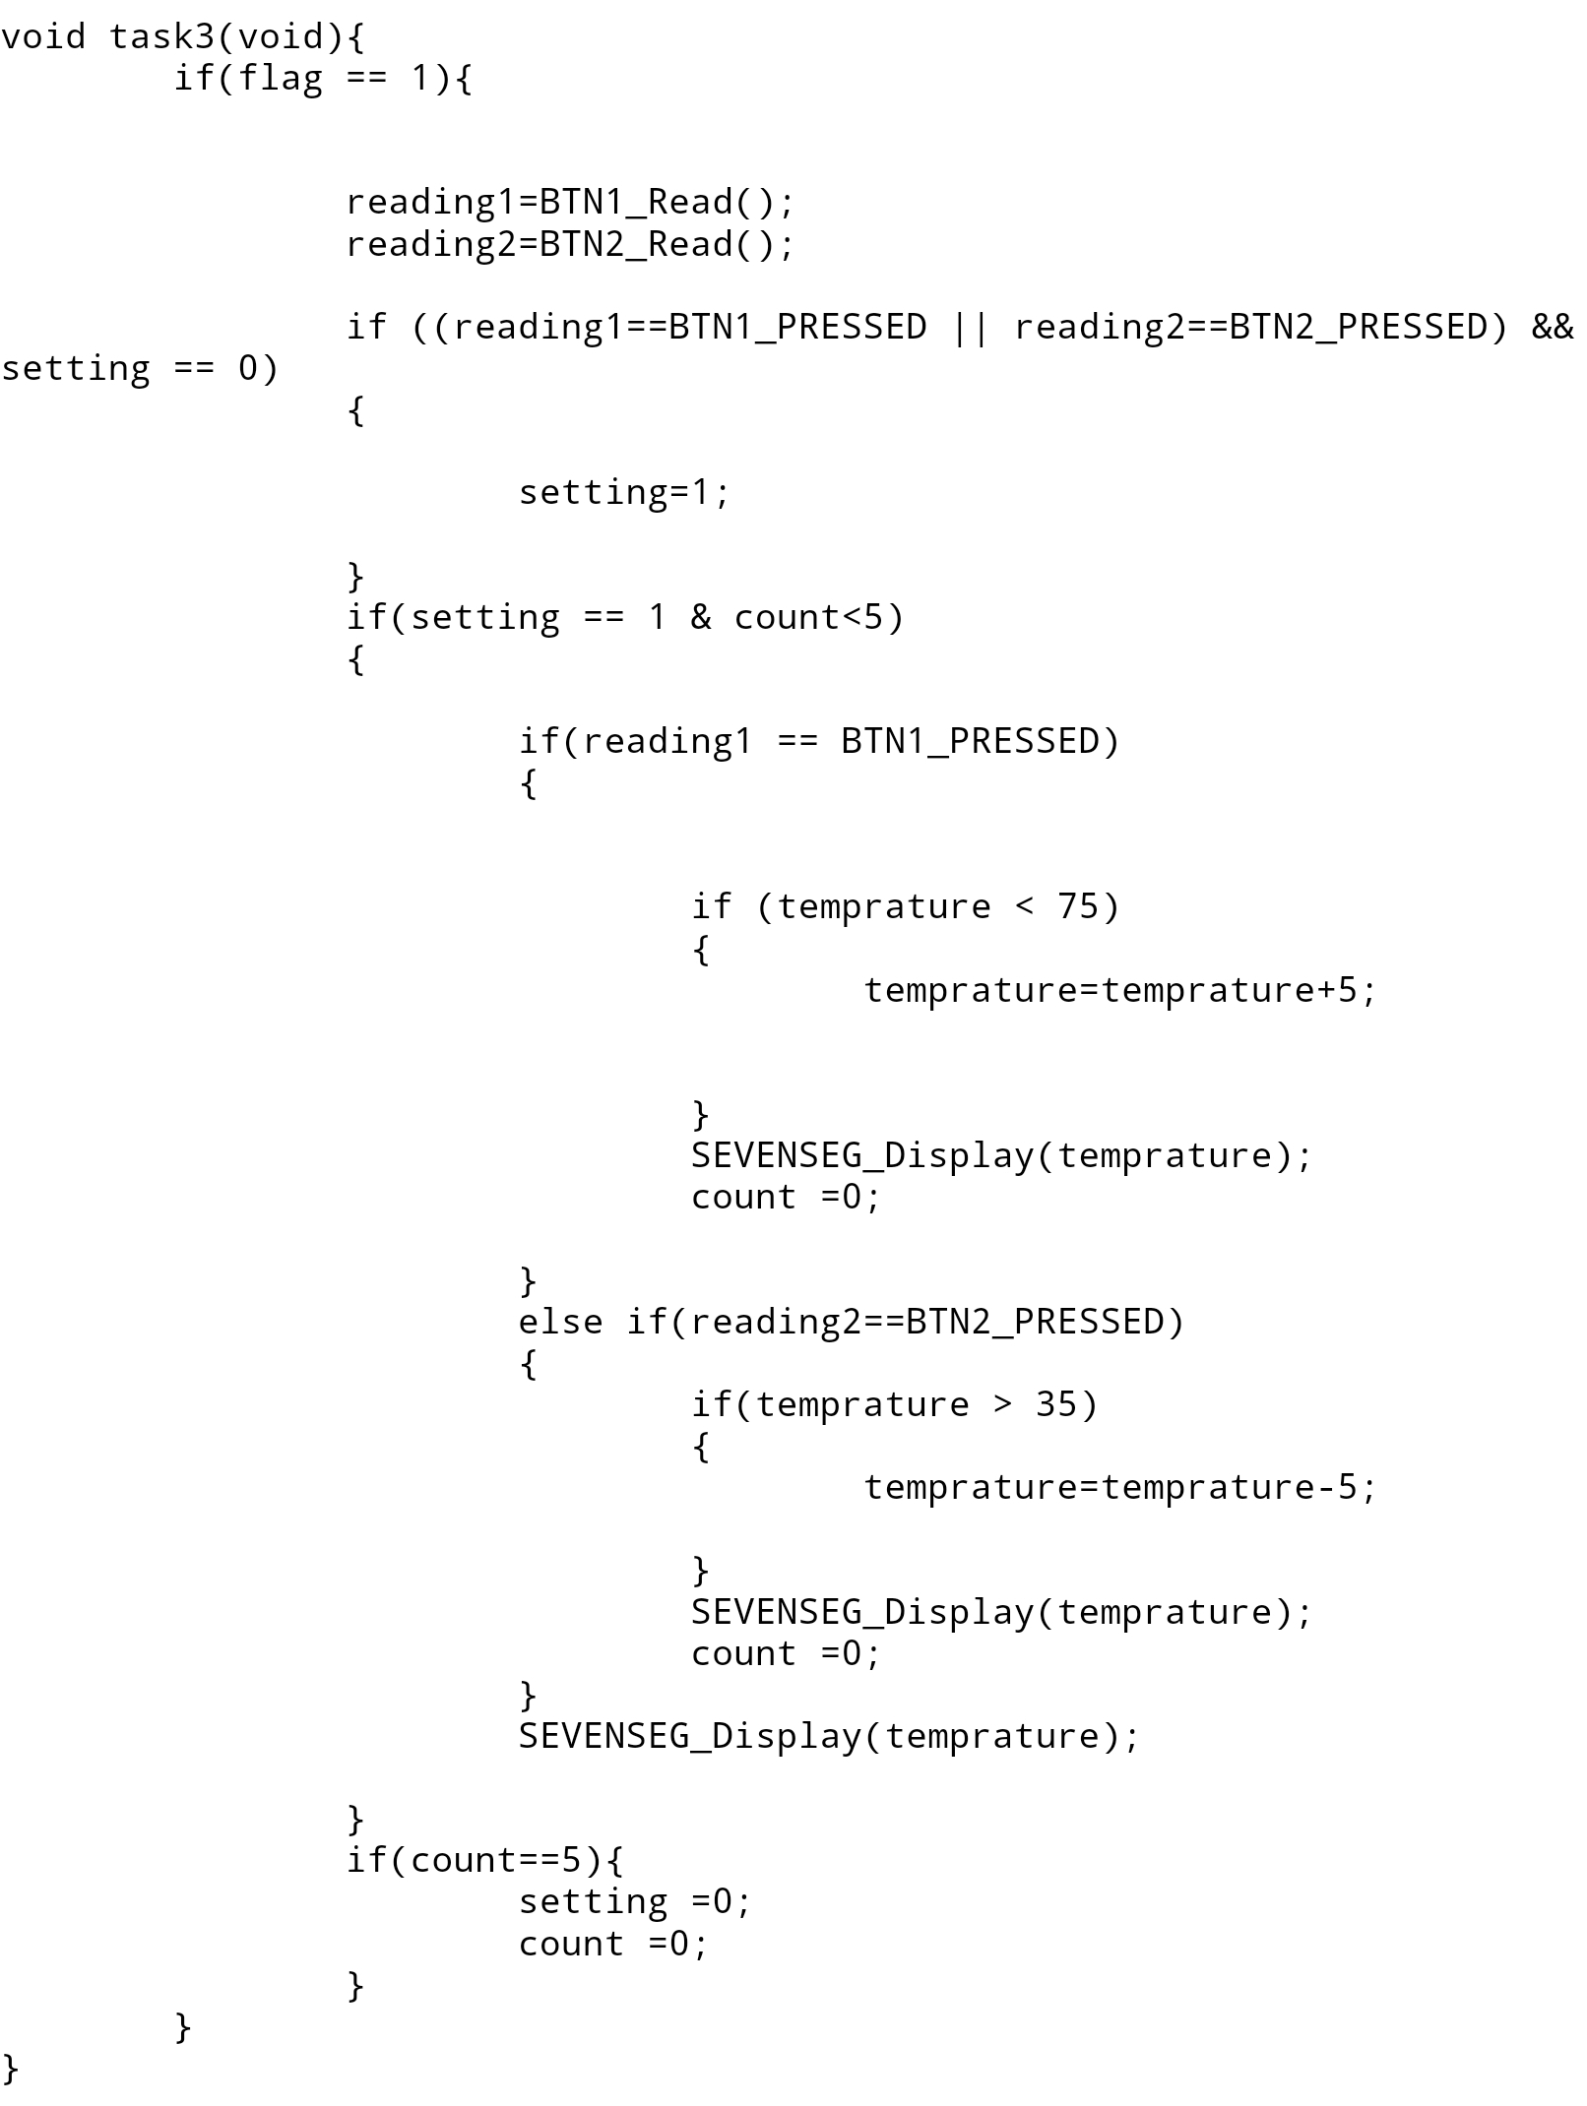
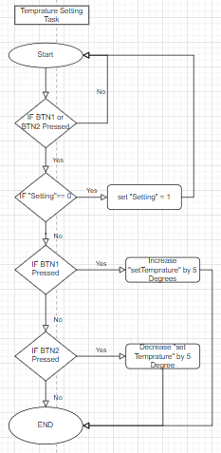
Task3: (Temprature Setting)

Slide 14
Task4: (Seven segment Bkinking)
At Start the seven segment display The sensed Temprature
Check if Setting Mode Entered
In Setting Mode ON, The sevensegment Blink Every one second
Seven Segment Display The set temprature
if setting mode is OFF the Sevensegment stop Blinking and Display The sensed Temprature

Slide 15
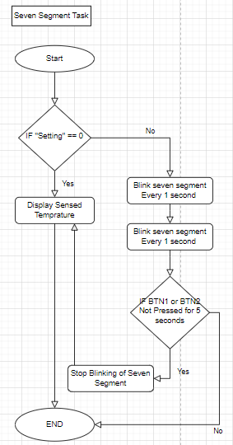
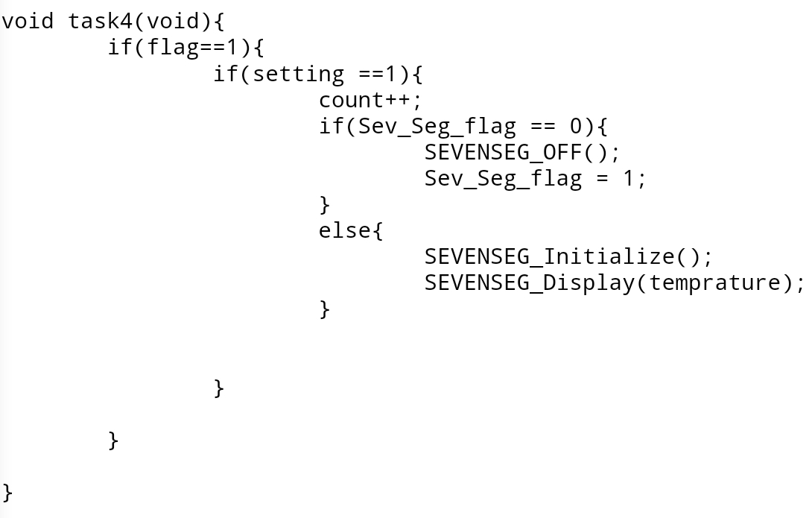
Task4: (Seven segment Bkinking)

Slide 16
Task5: (Heating and cooling system)
The Heating Element Start and Cooling Element stop when the Average sensed Temprature is less than the set tembrature by 5 degrees
The Heating Element stop and Cooling Element start when the Average sensed Temprature is greater than the set tembrature by 5 degrees.
The Heating Element Stop and Cooling Element stop when the Average sensed Temprature is equal than the set tembrature.

Slide 17
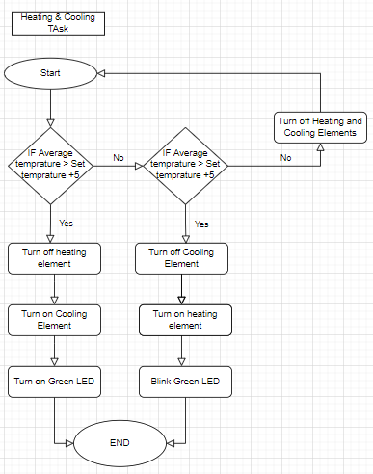
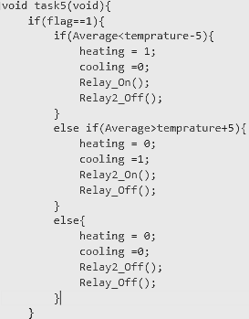
Task5: (Heating and cooling system)

Slide 18
Task5: (Heating /cooling LED)
The Green Led Start is OFF
When the heating Element Start the Led Blink
When the cooling Element start the led is on

Slide 19
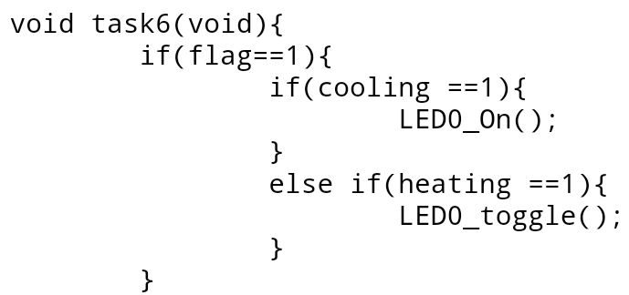
Task5: (Heating /cooling LED)

Slide 20
Thank You
Any Questions ?

